Slide 1
The
Appreciative Inquiry
Pack

Slide 2
Introduction
Appreciative Inquiry is a positive model for helping people, teams and organisations to develop. It invites people to focus on a specific topic they want to explore and then:
To clarify when they have performed brilliantly in this area in the past.
To clarify the principles they followed to perform brilliantly.
To clarify how they can follow these principles - plus add other elements - to perform brilliantly in the future.
This pack provides an introduction to AI. You can discover more at:
http://appreciativeinquiry.case.edu

Slide 3
Background
David Cooperrider began developing Appreciative Inquiry in the early 1980s. He was joined by other pioneers, such as Diana Whitney.
At that time David was completing his doctorate by doing organisational development work at The Cleveland Clinic. He began with traditional change management questions, looking at deficits and gaps in performance.
Then something happened. Impressed by the co-operation and innovation he found, David changed tack.
He focused more on people’s strengths and professional high points. He became fascinated by studying people, teams and organisations at their best.

Slide 4
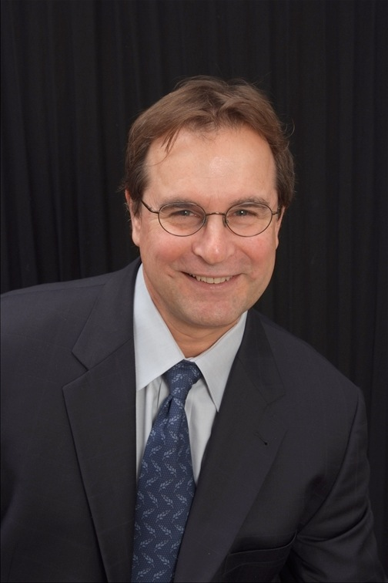
David Cooperrider
Diana Whitney

Slide 5
David asked the Clinic’s Chairman, Dr William Kiser, if he could focus totally on this positive approach and was encouraged to go ahead. David and his project supervisor, Suresh Srivastva, would later write:
“Human systems grow in the direction of what people study.”
Or, as others put it:
“What we focus on, we become.”
If we study success, for example, we are more likely to feel optimistic, rather than if we study failure. Certainly we can learn from studying how people overcome setbacks. But that is different from digesting a daily diet of failure.

Slide 6
People like the AI approach. They find that revisiting their successes inspires them to build an even better future.
This worked at the Cleveland Clinic. The staff loved learning from their past successes and wanted to follow these principles in the future. People translated these into tackling specific challenges and produced concrete results.
Diana Whitney worked with David on developing AI. They
then co-authored the first book on the topic. This was
called Appreciative Inquiry: A positive revolution in change.
Since then there have been many other books on the topic. These have often focused on how the approach is translated into action.

Slide 7
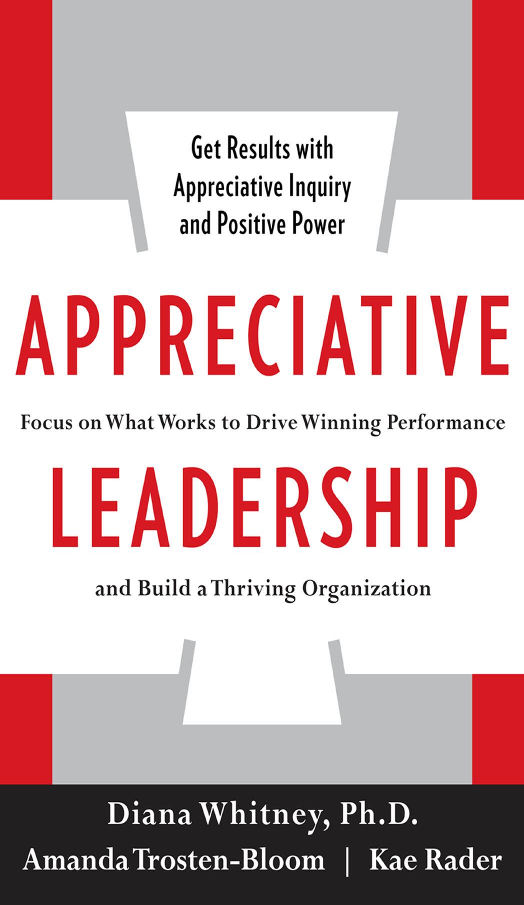

Slide 8
AI studies humanity at its best. It invites people to clarify when they have performed brilliantly - as individuals, teams and organisations. They can then follow these principles more in the future.
AI adopts an organic approach. It asks people to develop, rather than to change. Although the outcome may in fact be positive change.
People believe in the approach. AI shows that they have already done what works. They simply have to do it more – plus maybe add other elements – in the future.
This inspires them to follow the good habits. AI has a track record of delivering success. Let’s look at some of the principles behind AI.

Slide 9
Principles

Slide 10
Introduction
The AI approach starts by people defining the topic they want to explore. For example:
How can we provide great customer service?
How can we develop resilience?
How can we communicate well inside our organisation?
How can we raise morale in the business?
How can we achieve peak performance?
People then follow the 4D cycle that goes through the stages of Discovery, Dream, Design and Delivery. (In the original version the final stage was called Destiny.)

Slide 11
Appreciative Inquiry
You can start by defining the question or topic to be
explored. You can then focus on the following steps:
Discovery
Delivery
(Destiny)
Dream
Design

Slide 12
The art of Appreciative Inquiry revolves
around the art of asking questions
The starting point when tackling any challenge is to formulate certain questions. If possible, it is vital to frame these in a positive way. This helps:
To define the direction in which people can channel their energy.
To define the real results they want to achieve.
“But you can’t frame every challenge in a positive way?” somebody may say. Some situations are difficult to reframe, but this can be the starting point of the process.
Many AI practitioners, for example, help people to reframe things by using Flip Questions. They flip the energy towards a framing a positive goal.

Slide 13
If a person is continually describing what is wrong, for example, the AI practitioner will ask:
“So what do you want to happen? What is your picture of success?”
Sometimes a person – or group – may resist this approach. They may want to keep describing what is wrong, but this can be depressing and debilitating
People will ultimately need to define their picture of success. Flip Questions encourage them to channel their energy in this direction.

Slide 14
Defining The Topic
The Definition process is one that some people see as the Fifth D in the AI framework. It comes before focusing on Discovery, Dream, Design and Destiny.
Defining the topic is the process that AI calls Affirmative Topic Choice. Creative people often frame their challenges in a positive way. They move from saying:
“How can I stop feeling bad?” to: “How can I start feeling good?”
“How can we stop arguing?” to: “How can we, as far as possible, find a win-win?”
“How can reduce sexual harassment?” to: “How can we encourage women and men to work together successfully?”

Slide 15
David was actually confronted by this final topic. One day he received a phone call from a consultant who was helping a company to tackle sexual harassment.
During the previous two years the employees had been attending training designed to eliminate this issue. The levels of sexual harassment were actually increasing, however, as were the lawsuits against the company. The consultant in charge of the gender and diversity training asked David:
"How would you take an appreciative approach to sexual harassment?”
David asked about the real results to achieve. The reply was:
"We want to dramatically cut the incidence of sexual harassment. We want to solve this huge problem."

Slide 16
Going deeper, he asked what this would look like. The consultant said:
“What we really want is to see the development of a new century organisation - a model of high quality cross-gender relationship in the work place!”
Though this wording was somewhat awkward, it clarified a positive picture of success. So eventually the questions posed to people during the following Discovery stage were along the lines of:
“When have women and men have worked together successfully in the company? What did they do right then? How can we follow those principles in the future?”
The company introduced a small pilot programme on this theme. This exceeded everybody’s expectations.

Slide 17
Hundreds of pairs and teams nominated themselves to provide stories illustrating men and women working together successfully. This led to producing tangible results and achieving the picture of success.
Imagine you are working with a team that wants to use AI. The first step will be to define the topic. For example, people may want:
To tackle a specific challenge.
To explore a specific topic.
To achieve a specific goal.
Here are some things to bear in mind when defining the topic. Doing this properly provides the framework within which people can channel their positive energy. They then move on to the 4D framework.

Slide 18
Defining The Question
Start by asking:
“What is the challenge we want to tackle?
“What is the theme we want to explore?
“How can we frame the question in a positive way?
“What are the real results we want to achieve? What is the picture of success?”
If appropriate, people can define the challenge, topic or specific results they want to achieve in terms of:
“How to …?”

Slide 19
Discovery

Slide 20
Introduction
Let’s imagine you have defined the topic to explore. The Discovery phase now taps into the positive core – the life-giving forces of a team, organisation or community.
AI invites people to clarify what works. It asks them to describe times when they have performed well in the area they are exploring. It aims to Discover the stories, strengths and successful principles already within the system.
AI practitioners apply this approach in teams, in organisations or literally across thousands of people when tackling community issues. The latter approach is sometimes called an AI Summit.
Here is a framework people can use during the Discovery stage and, if appropriate, present these findings back to the team.

Slide 21
Looking back, invite people to ask:
“When have we done good work in this area? When have we tackled similar challenges successfully?”
Invite them to do the following things.
Describe specific situations when they have performed well when dealing with similar situations.
Describe the specific things they did right - the principles they followed - to do successful work.
Invite people to present their findings back to the whole team. They can do this by using the following framework.

Slide 22
Discovery Presentation
The specific examples
we focused on were:
* When …
* When …
* When …

Slide 23
The principles people followed - and the specific things
they did to translate these principles into action - were:
* They …
For example …
* They …
For example …
* They …
For example …

Slide 24
Dream

Slide 25
Introduction
People can focus on how they can follow the principles they believe in - because they know these work - and express these in a dream.
People can make sure the dream is stimulating and stretching. They can make sure the goals are within the scope of what they can control in the situation.
People can make sure they are serious about achieving the dream. They can clarify the pluses and minuses involved - for all stakeholders - and make sure they are prepared to accept the whole package.
People can draw a picture or representation of them achieving the dream. They can put this in a place where they can see it each day.
Here is a framework they can use to present their ideas.

Slide 26
Dream Presentation
The dream we want to achieve
- the picture of success - is:
* To …
* To …
* To …

Slide 27
Design

Slide 28
Introduction
People will have their own approach to clarifying their strategies for achieving the dream. Here are some of the questions they may ask when creating their plan.
“What are the key strategies we can follow to give ourselves the greatest chance of success? How can we implement these strategies successfully?
“What are people’s strengths? How can we co-ordinate these strengths to achieve the goal? How can we compensate for any weaknesses?
“What is the road map - the specific action plan - for achieving the goal? Who needs to deliver what and by when? What will be happening that will show we have achieved the dream?”
Here is a framework they can use to present their ideas.

Slide 29
Design Presentation
The key strategies we can
follow to achieve the dream are:
*
*
*

Slide 30
The specific kinds of support that people
will need to achieve the dream are:
*
*
*

Slide 31
The specific action plan- including the key milestones
along the way - for achieving the dream is:
*
*
*

Slide 32
Delivery
(Destiny)

Slide 33
Introduction
People can be encouraged to use the following framework for updating others about their contributions towards achieving the dream. They can make the following presentations each month.
The specific things we have delivered in the past month towards delivering the dream.
The specific things we aim to deliver in the next month towards delivering the dream.
The specific challenges we face and our plans for tackling these challenges.
The specific kinds of support we would like to help us to deliver the dream.
The specific other topics we would like to explore regarding how to deliver the dream.

Slide 34
The Past Month
The specific things we have delivered in the past
month towards delivering the dream have been:
*
*
*

Slide 35
The Next Month
The specific things we aim to deliver in the
next month towards delivering the dream are:
*
*
*

Slide 36
The Challenges
The specific challenges we face and our
plans for tackling these challenges are:
*
*
*

Slide 37
The Support
The specific kinds of support we would
like to help us to deliver the dream are:
*
*
*

Slide 38
The Other Things
The specific other topics we would like to explore
regarding how to deliver the dream are:
*
*
*

Slide 39
Conclusion
This pack has provided an introduction to Appreciative Inquiry.
There are, of course, many dimensions to the themes that have been described in this pack. You can discover more about the background and practical tools on the following website.
http://www.thepositiveencourager.global/
There is lots of material on the website. If you want to explore a particular theme further, it may therefore be best to contact me directly. You can reach me at the following address.
mike@thepositiveencourager.global

